Slide 1
Temporal Visual Analytics for Additive Manufacturing
Chad A. Steed, Ph.D.
http://csteed.com
Computer Science and Mathematics Division
Oak Ridge National Laboratory

Slide 2
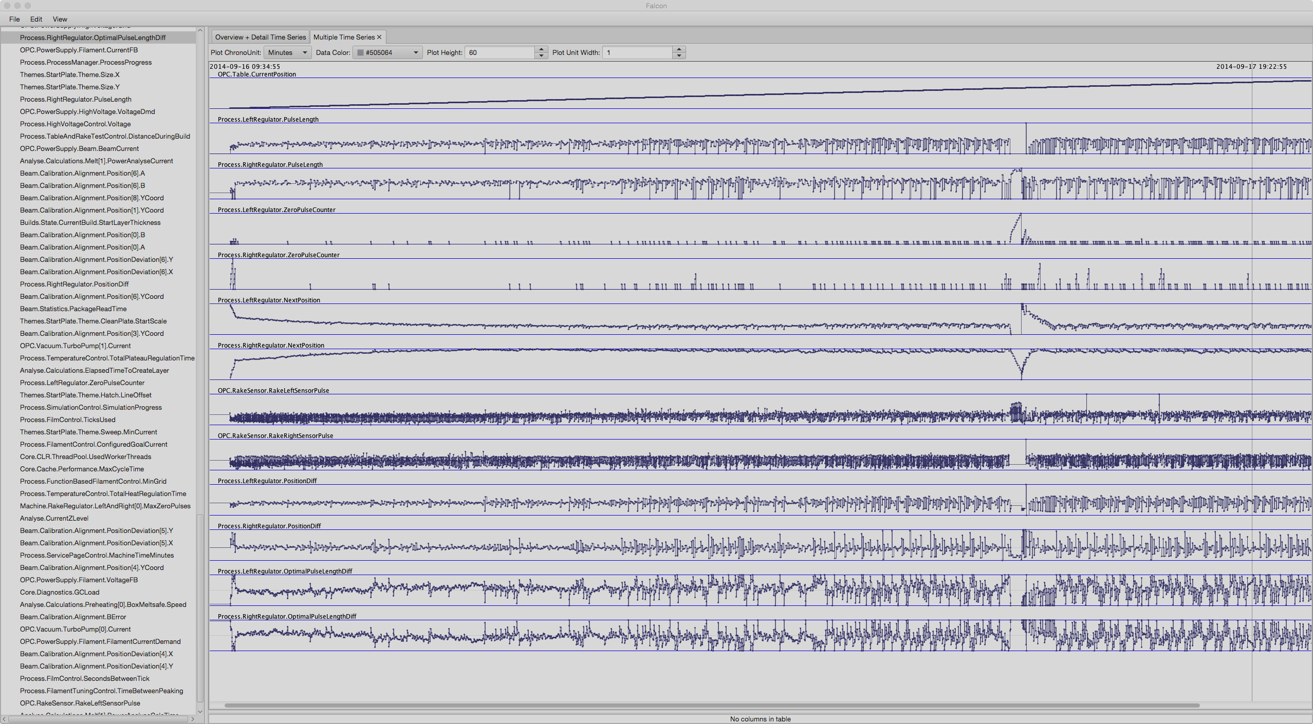
DATA
Insight

Slide 3
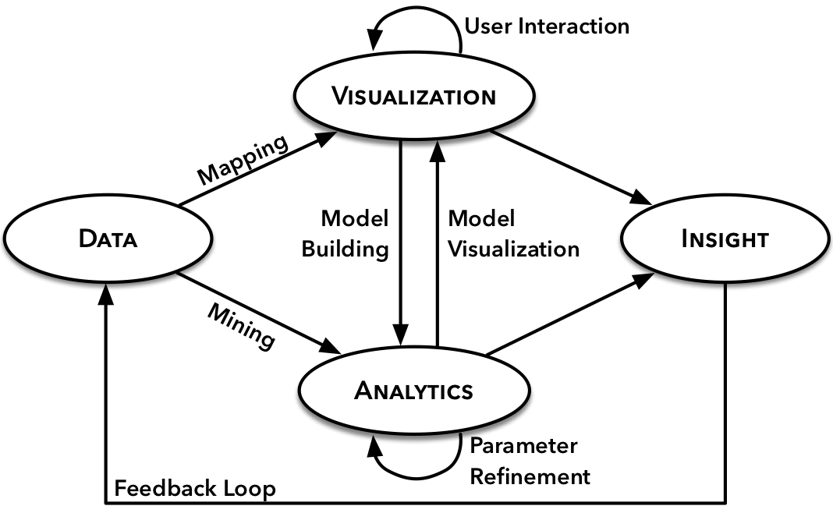
Visual Analytics: Uniting Humans and Computational Strengths

Slide 4
Additive Manufacturing
Transformation of the manufacturing process
Greater geometrical freedom
Less material waste
Need to certify quality of 3D printed objects to unlock the full potential
Requires a deep understanding of the log and imagery data from printer builds
Excellent scenario for visual analytics tools

Slide 5
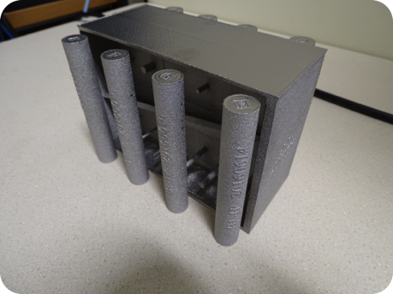
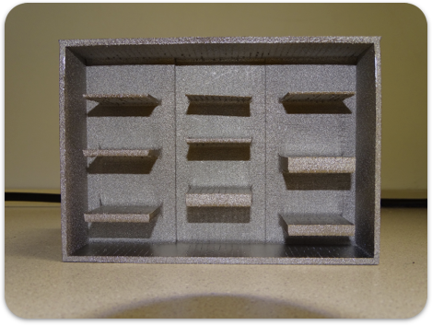
Examples of 3D Printed Objects (The Good)

Slide 6
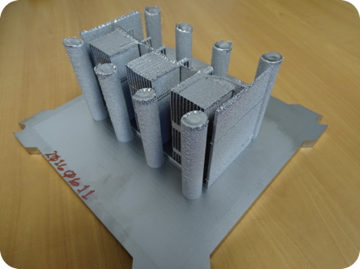
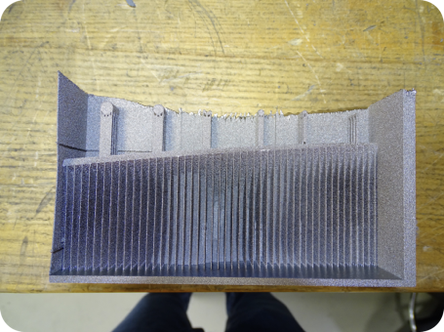
Examples of 3D Printed Objects (The Bad)

Slide 7
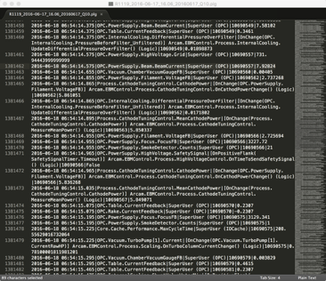
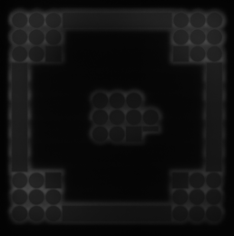
3D Printer Log and Imagery Data
Log files are integral to understanding the process, but challenging:
Long builds (hours)
Large (millions of readings)
Multivariate (thousands)
Irregularly sampled
Semi-structured text format
Multi-modal (imagery data)
Off the shelf tools are inadequate

Slide 8

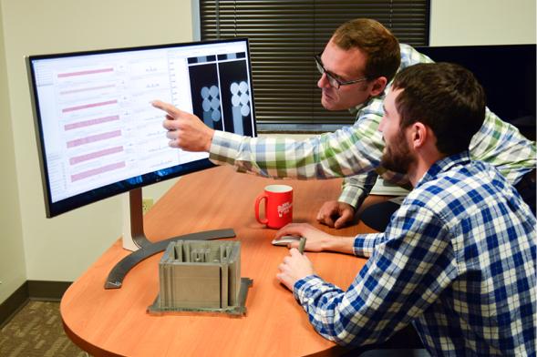
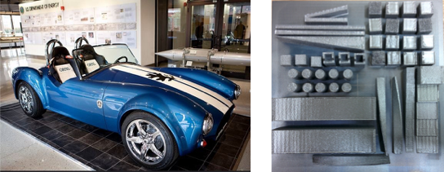
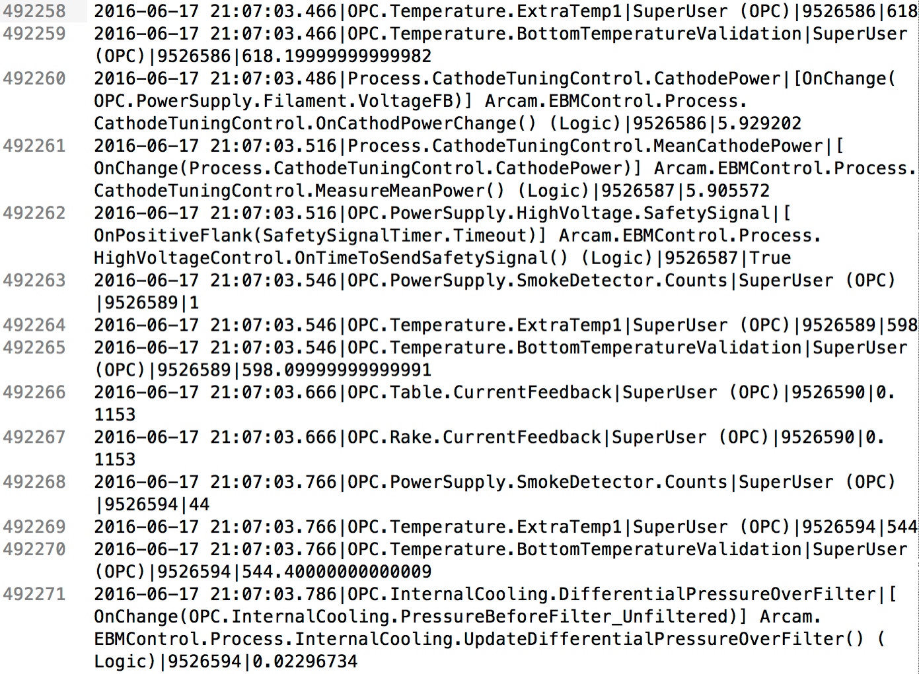
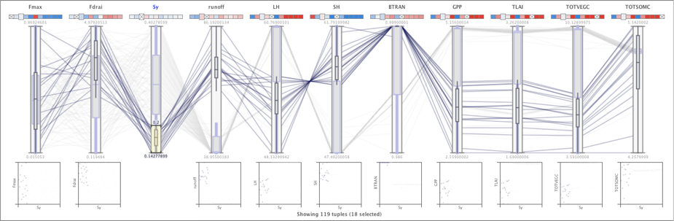
Participatory Design of a New Visual Analytics Tool
Domain Experts
Dr. Ryan Dehoff
Additive Manufacturing
Scientific Domains
Large-scale 3D Printing
Real-world Data
Large, Complex, Unique
Results / Artifacts
Tools, Techniques,
Publications, Patents,
Open Source Software

Slide 9
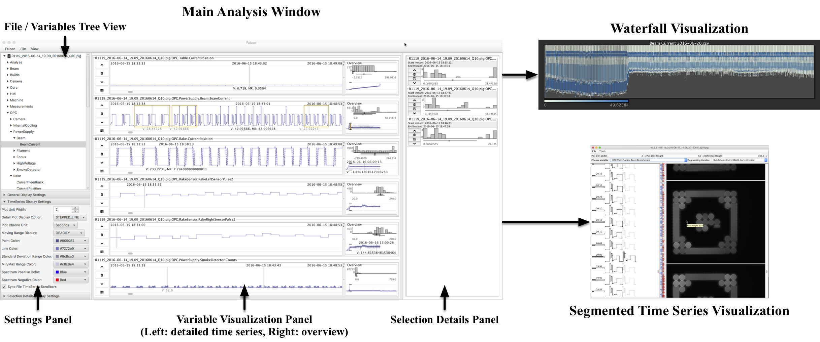
Introducing Falcon

Slide 10
Data Transformation and Modeling
Log files are read into time-based bins at variable levels of detail
Support drill down / roll up between overviews and detailed visualizations
Statistical summaries derived from raw data
Only read variable data into memory if requested
CSV import or custom reader available

Slide 11
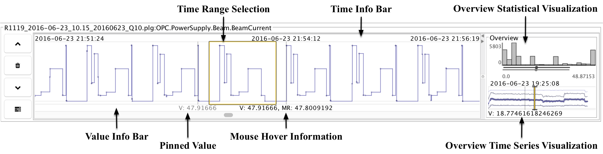
Variable Visualization Panel
Consists of 1 detail visualizations and 2 overviews for a particular variable of interest (stacked for multiple variables)
Interactions within each view are linked
Details-on-demand capabilities

Slide 12
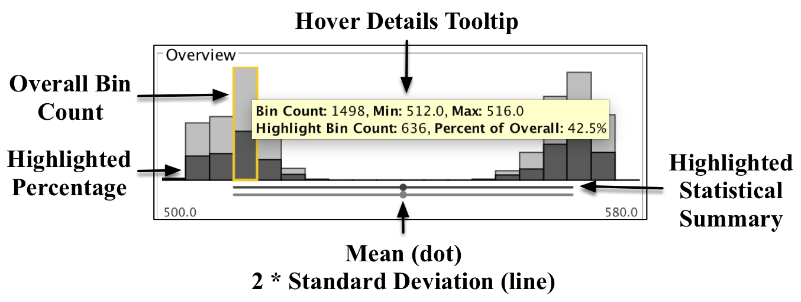
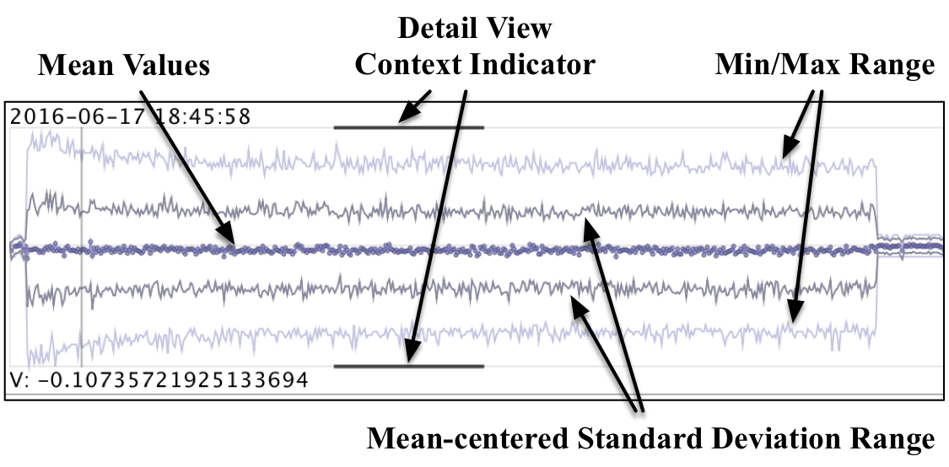
Overview Variable Visualizations

Slide 13
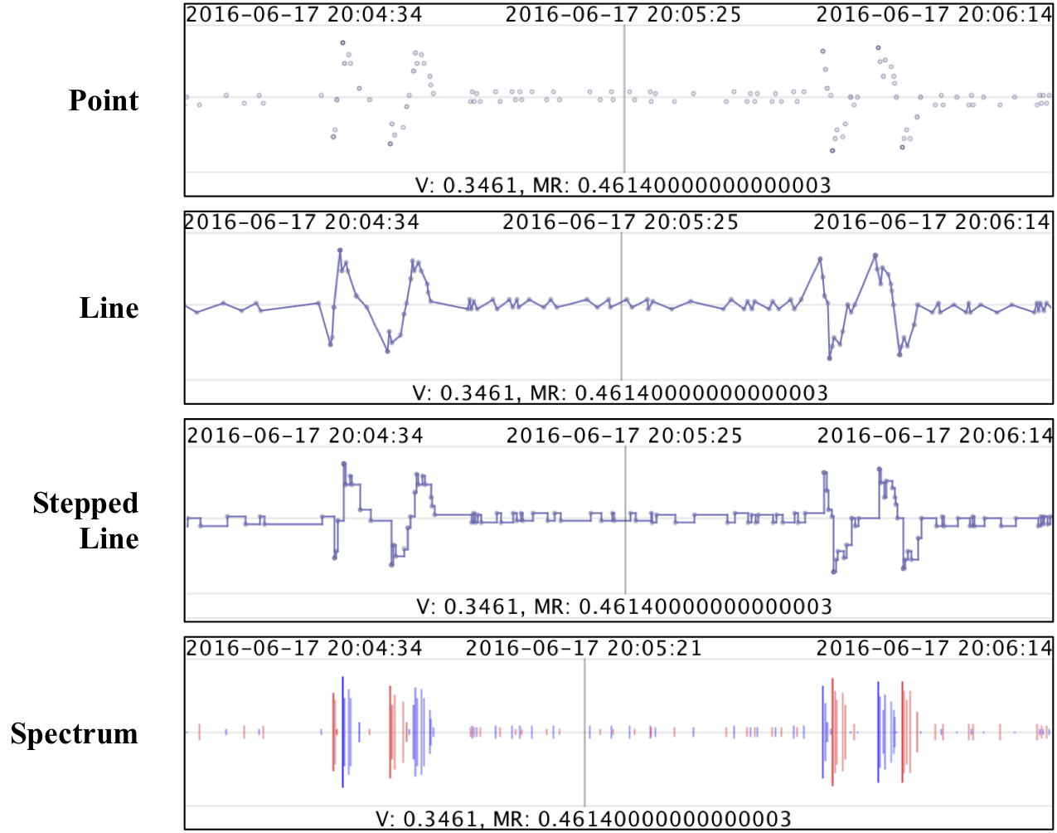
Detailed Time Series Visualization Modes

Slide 14
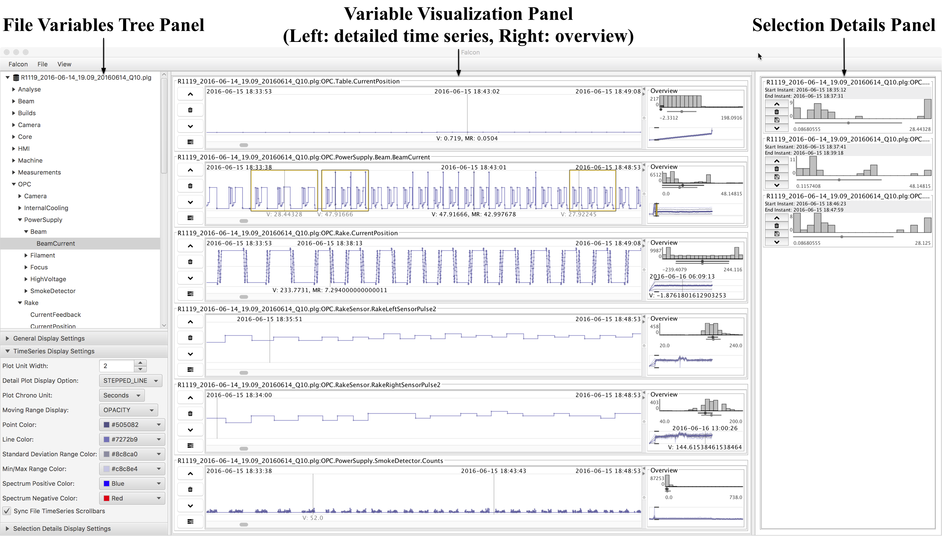
Selection Details Visualization Panel

Slide 15
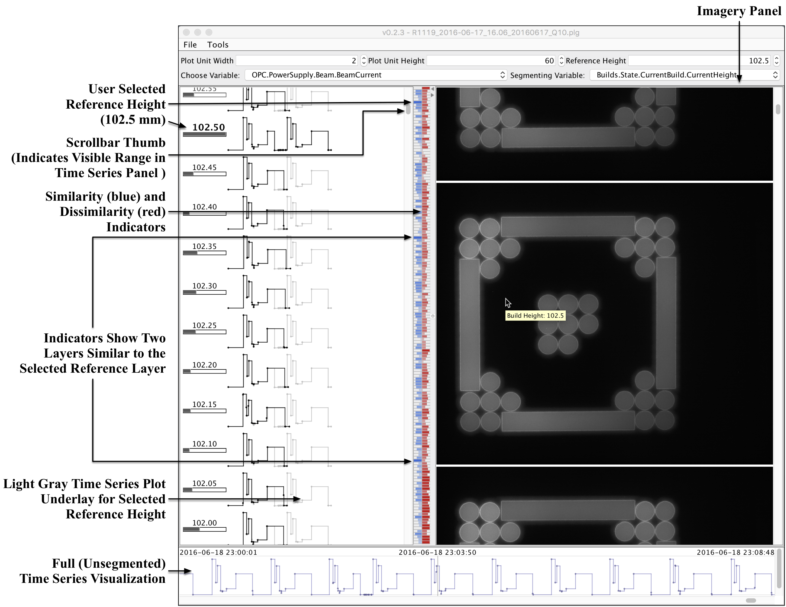
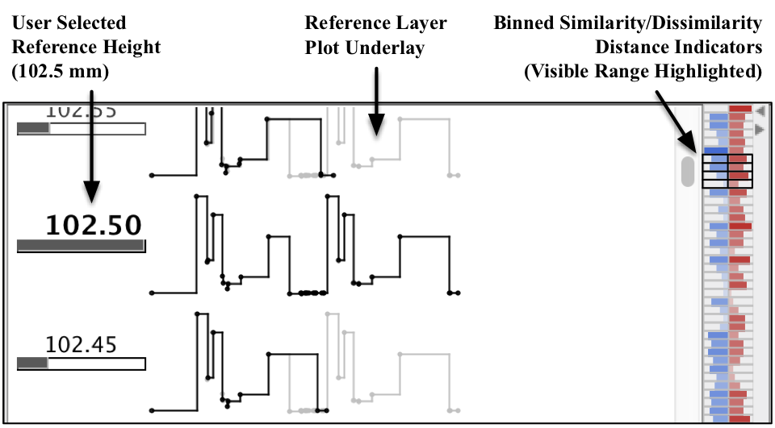
Segmented Time Series Visualization (Layers + Imagery)
Closeup of Similarity Metrics

Slide 16
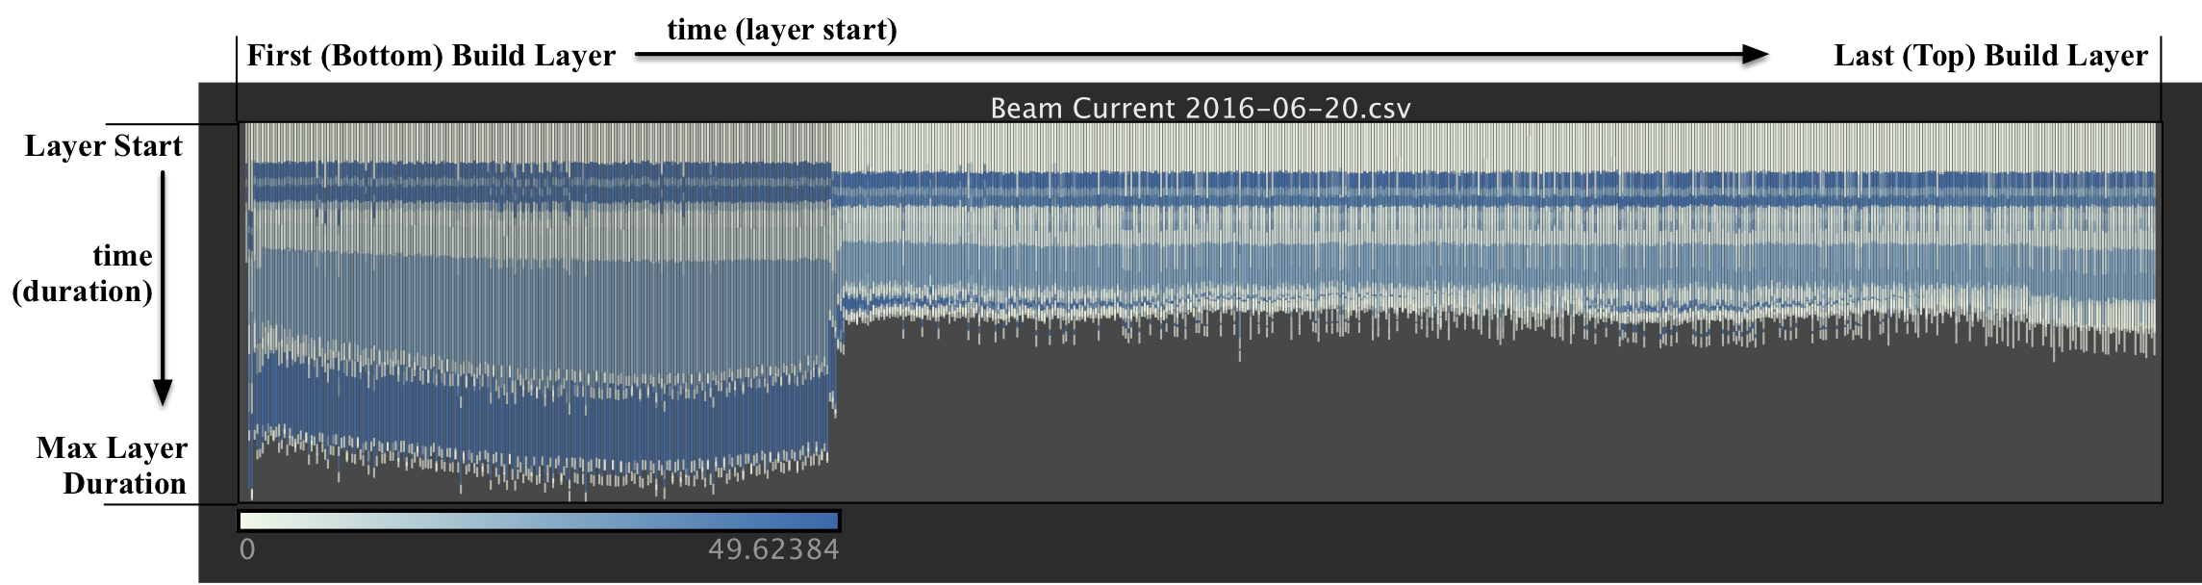
Waterfall Visualization (DNA Plot of a 3D Print)

Slide 17
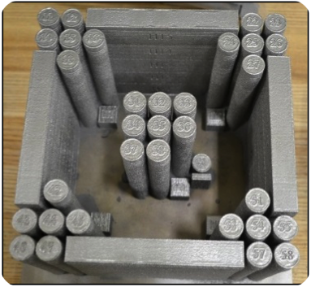
Case Study: Analysis of 3D Printer Build
Arcam Q10 3D Printer System
Uses electron beam melting to synthesize metallic objects
Data from the build of a special test configuration used to ensure the Q10 system is functioning properly
Four distinct geometrical layouts and 5 specific features
Created entirely from the build platform without support structures

Slide 18
General Analysis Strategy Using Falcon
Overview First
Researchers naturally gravitated toward a workflow that parallels Shneiderman’s visual information seeking strategy*
Being with overview of key variables
Drill down to explore patterns
Note interesting patterns and trends along the way
Combine log and imagery data for big picture
Follow-up with physical investigations to validate findings (e.g., scanning microscopy)
Zoom and Filter
Details on Demand
* B. Shneiderman. “The eyes have it: A task by data type taxonomy for information visualizations.” In Proceedings of the IEEE Symposium on Visual Languages, pp. 336–343, 1996.

Slide 19
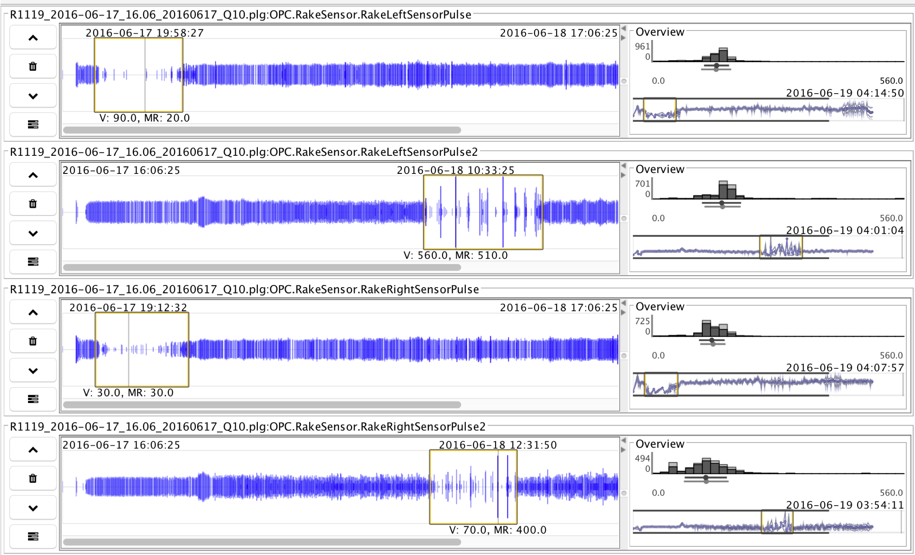
Overview First
Notes:
Use spectrum time series plot mode to study four rake sensors over the entire build.
Normal build should show minimal variation w/o large gaps
Here the gaps and spikes may indicate problems with the powder bed consistency or rake blade which warrant further investigation
Spectrum plots excels at revealing such conditions

Slide 20
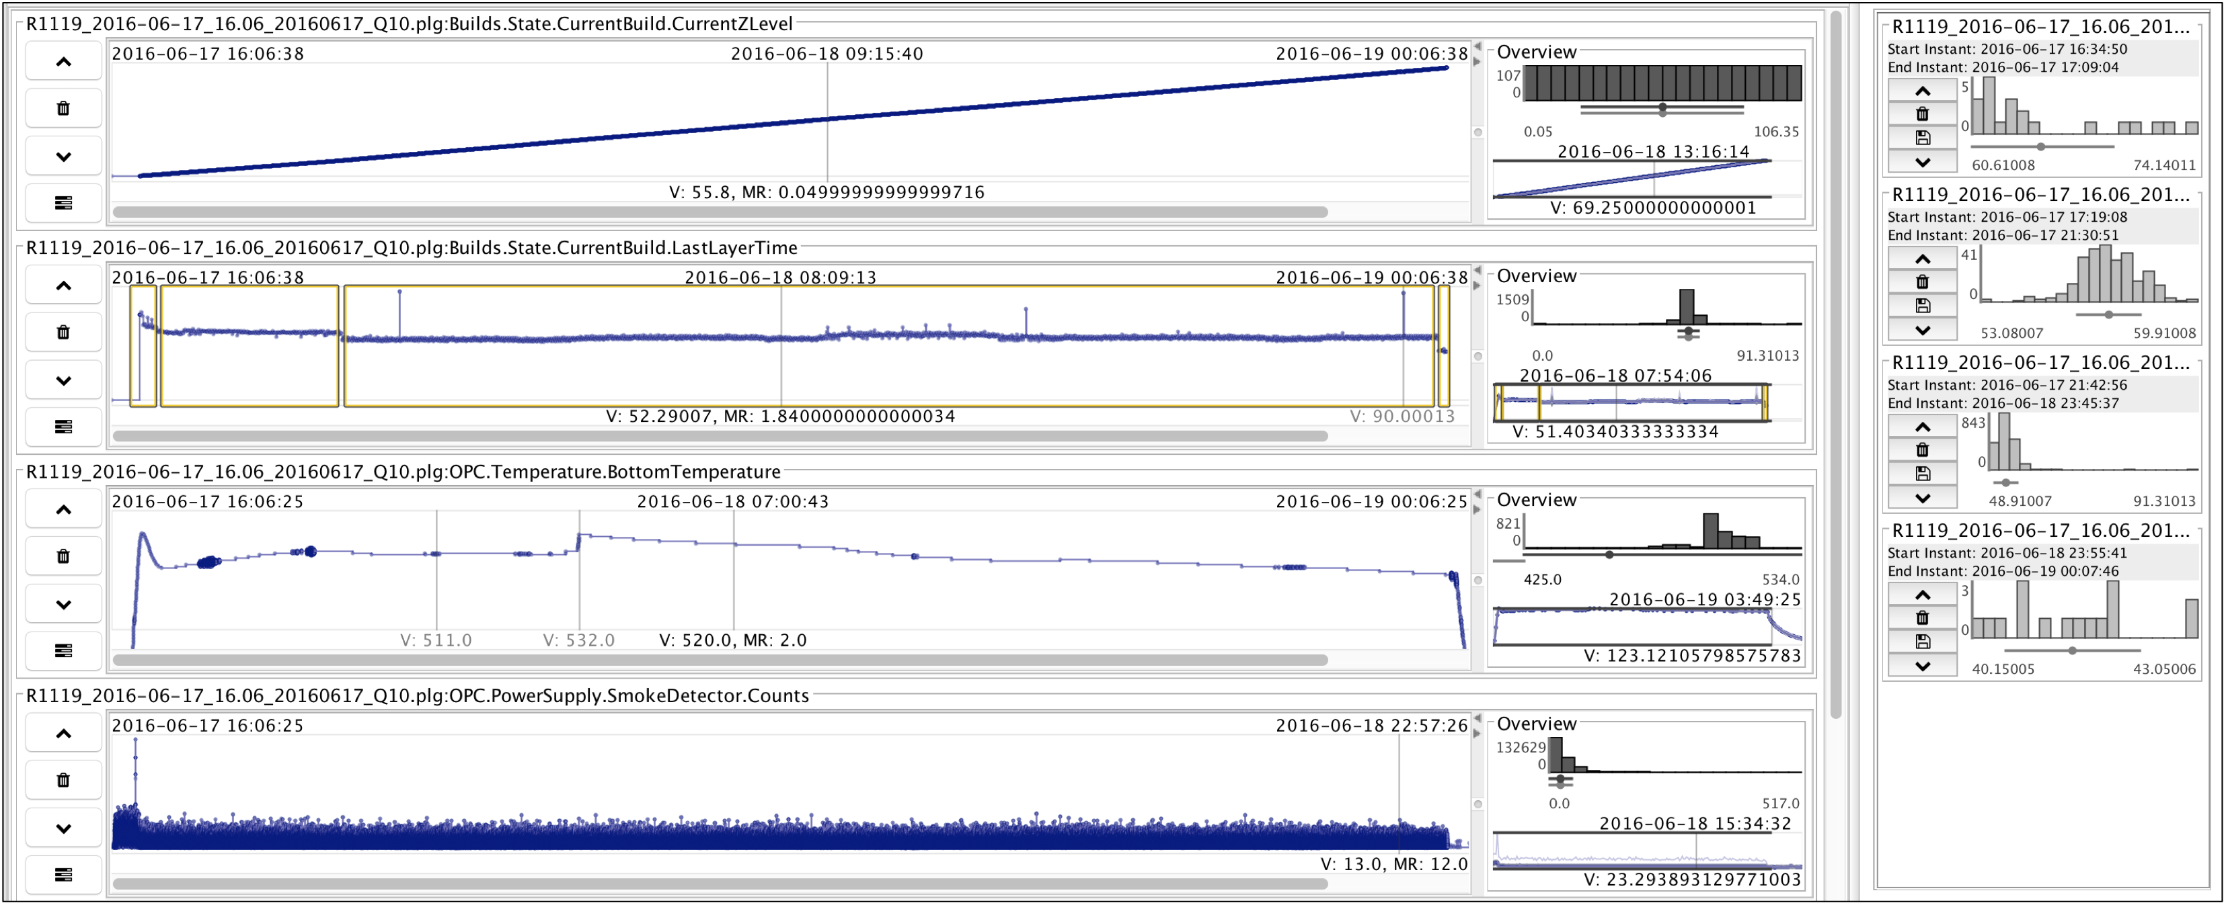
Overview First
Notes:
A set of key variables are always explored as an overview by manipulating the time scales of the details plot.
Key variables based on experience with using the tool
Many other variables are also considered in a normal session but we focus on a handful here
Here we have about a 2-min. resolution and four key variables
Z level is normal (ht. in mm from bottom layer)
Eye is drawn to bottom temp plot where abnormal pattern is detected; warrants additional investigation as it may indicated a change in processing params due to geometry of the object
Last layer time, related to last layer’s melt area.
Four distinct stages are selected
Third selection range holds three outlier layers. Skew histogram plots.
Suggest something bad occurred in preceding layer; warrant more study

Slide 21
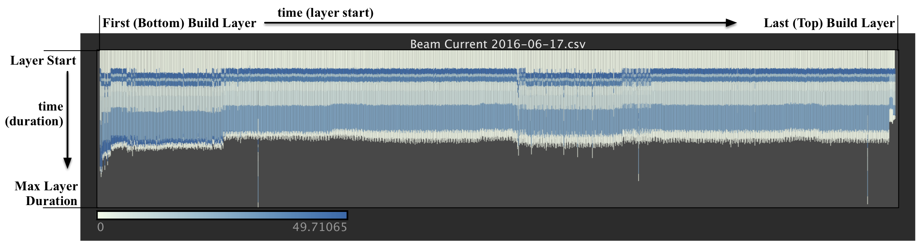
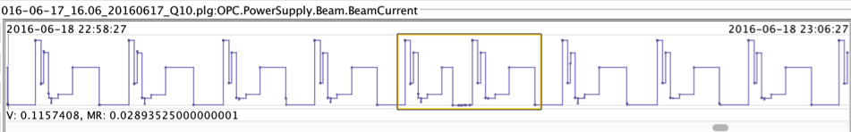
Overview for Particular Variable (Electron Beam Current)
Notes:
Focused view on beam current
4 distinct geometry regions are seen again
three outliers are easily spotted
Also more subtle variations are seen that may be overlooked in the first view.
Slight variances in the preheat stages of each layer
Smaller variations in layer duration in the middle of the build.
Those variations would warrant additional study but we will focus on the more drastic anomalies here for the sake of brevity

Slide 22
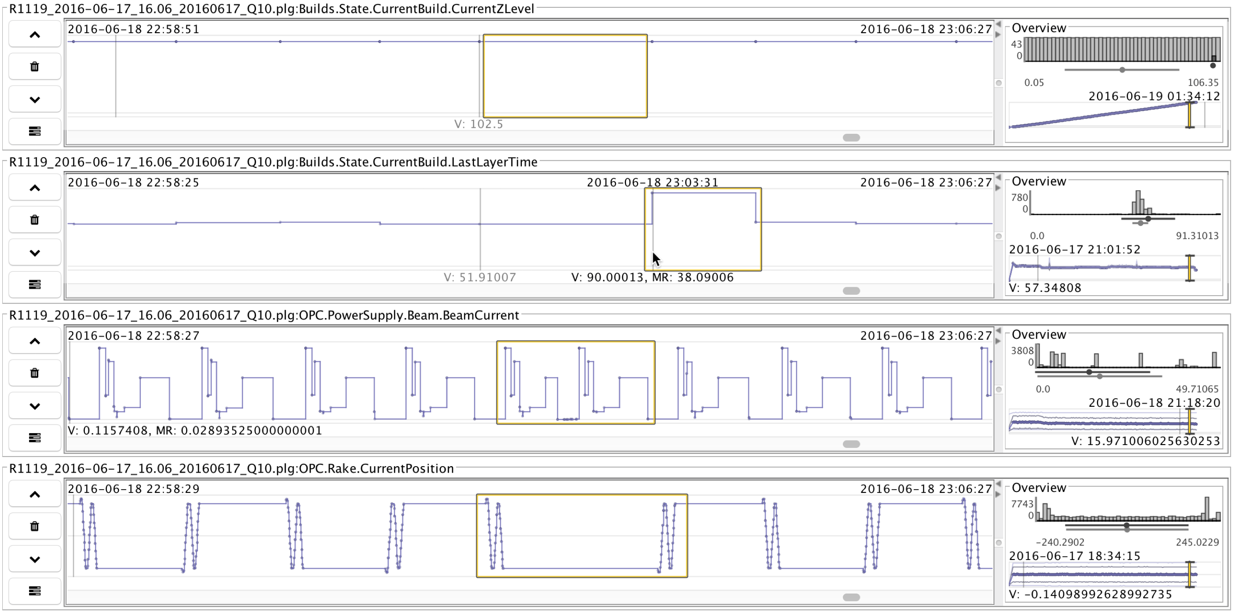
Zoom and Filter
Notes:
Zoom into the detail time series by changing the time scale settings to investigate one of the outlier layer times
We see signals of the increased layer time.
Repeat pattern in beam current visualization
Caused by an arc trip, that may indicate problems in the microstructure of the printed objects

Slide 23
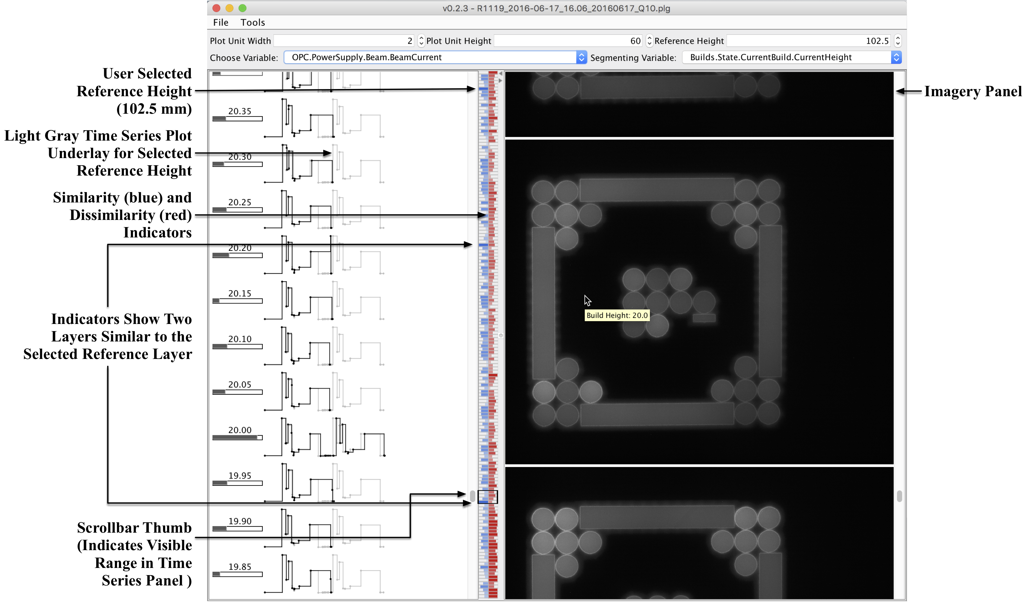
More Detail, on Demand
Notes:
Highest level of detail.
Changes in build height are used to segment full time series into individual layer plots
Selected outlier at the top of the build.
Dynamic time warping metric shows similarities at other locations in the build (other two outliers)
Suggests they may be related
Underlay plot for selected layer lets us compare directly
Slight shift at 20mm layer but appears very similar
At right we can study near IR to look for porosity, hot spots, etc. (appears normal here)
Result from analysis is that the anomalies were caused by arc trips.
Ruled out possibly of a smoke detection event by analyzing smoke detector plot
Further study using high resolution microscopy to study the effects in microstructure.

Slide 24
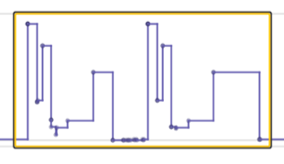
Identifying the Cause of the Outliers
Two possibilities:
Smoke Detector Reset
Arc Trip
Both cause signal repeats
Here, arc trip is the cause
This insight led to additional study to see how arc trips affect the microstructure of a build.
Notes:
We narrowed down the cause of these outliers to either an arc trip or a smoke detection event.
Both conditions are causes for questioning the integrity of the build
When beam is shut off during melting stage, microstructure of layer can be altered
Consistent microstructure is essential for creation production quality parts
Smoke event happens when powder particles are ionized in the vicinity of the electron gun.
Dust cloud can harm the beam filament
Beam shuts off and layer print is restarted, which visually looks like a repeated signal
We rule out a smoke detection event because the plot looks normal
Arc trip occurs when the beam forces too much energy through the filament.
System responds by immediately shutting off the beam and restarting the layer build process
Also looks like a repeated signal in plots
Here the causes are arc trips.
Additional study of the builds will help us see how these scenarios affect the microstructure of the print.

Slide 25
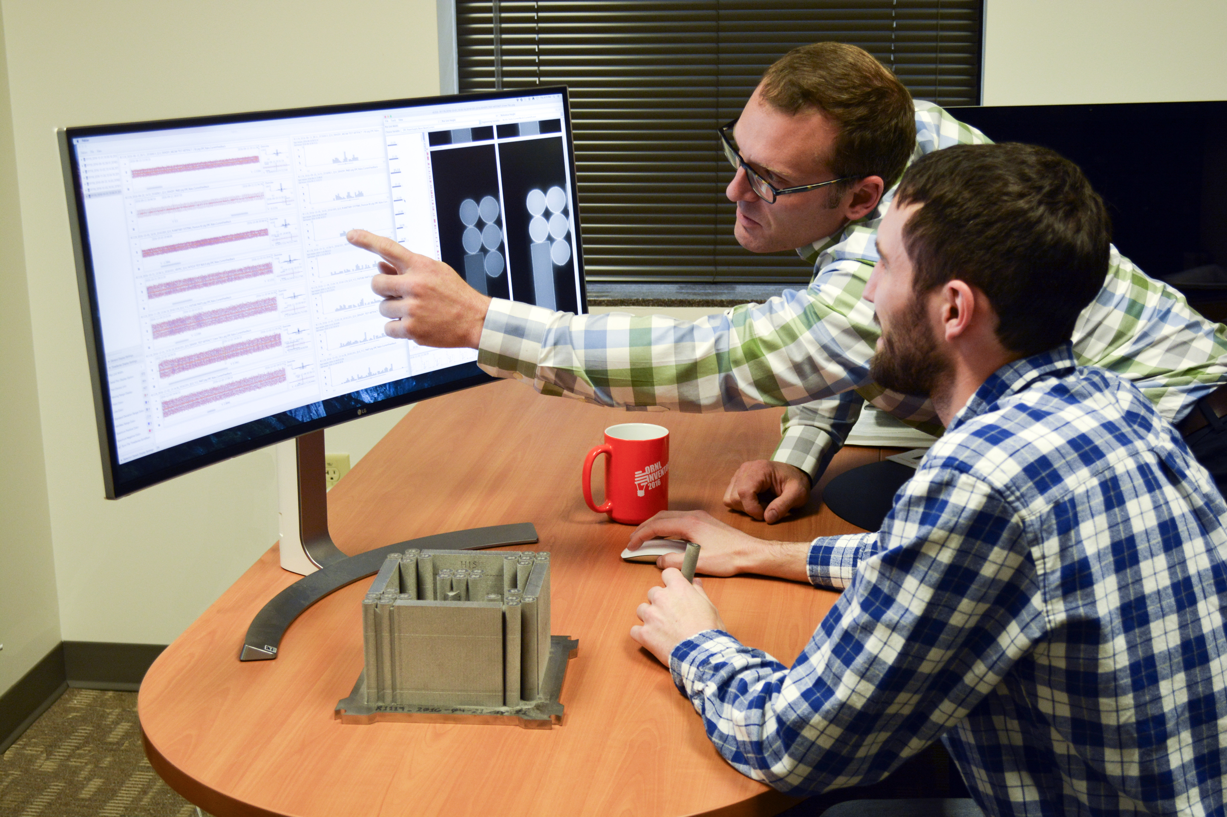
Discussion
Participatory Design works well
Co-designed system features
Domain experts vested in the work
General vs. domain specific capabilities
Limitations / Future Work
Session saving capabilities
Automated provenance tracking
Expanded multivariate visualizations
Automated pattern matching algorithms

Slide 26
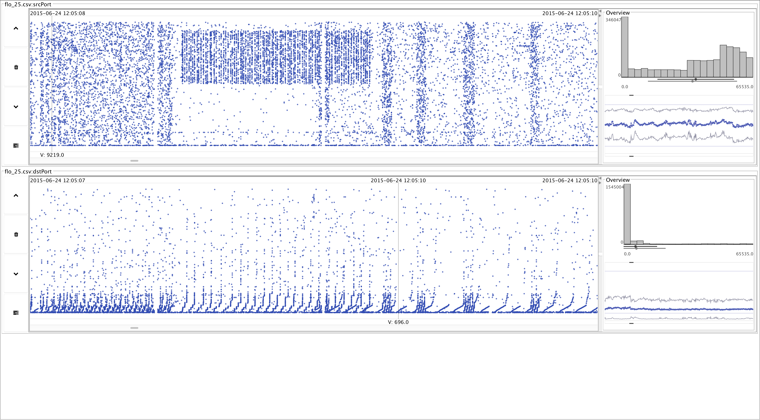
Other Applications (Network Flow Analysis)

Slide 27
Conclusions
Falcon enables significant discoveries that:
Help us formulate future automated predictive analytics
Help improve understanding of complex multivariate relationships
Falcon has already enabled improvements to the 3D printing process
Practical results demonstrate improvements over traditional, general purpose tools
Readily available (open source) and applicable to other domains.
Advantages of following the InfoVis Mantra
Strive to include domain experts in new data science research

Slide 28
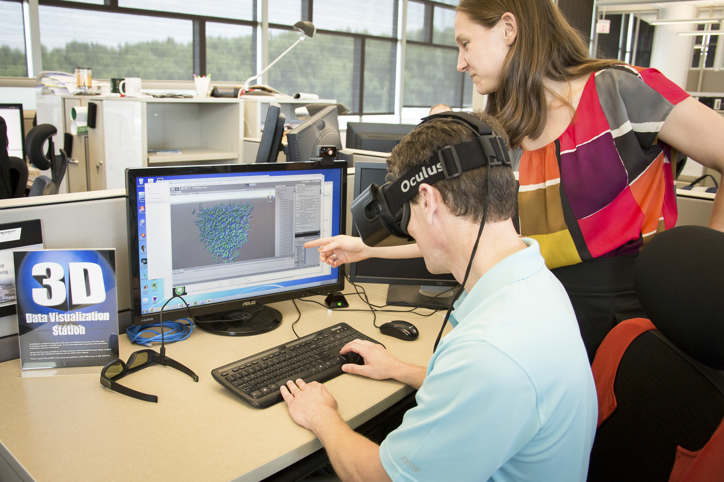
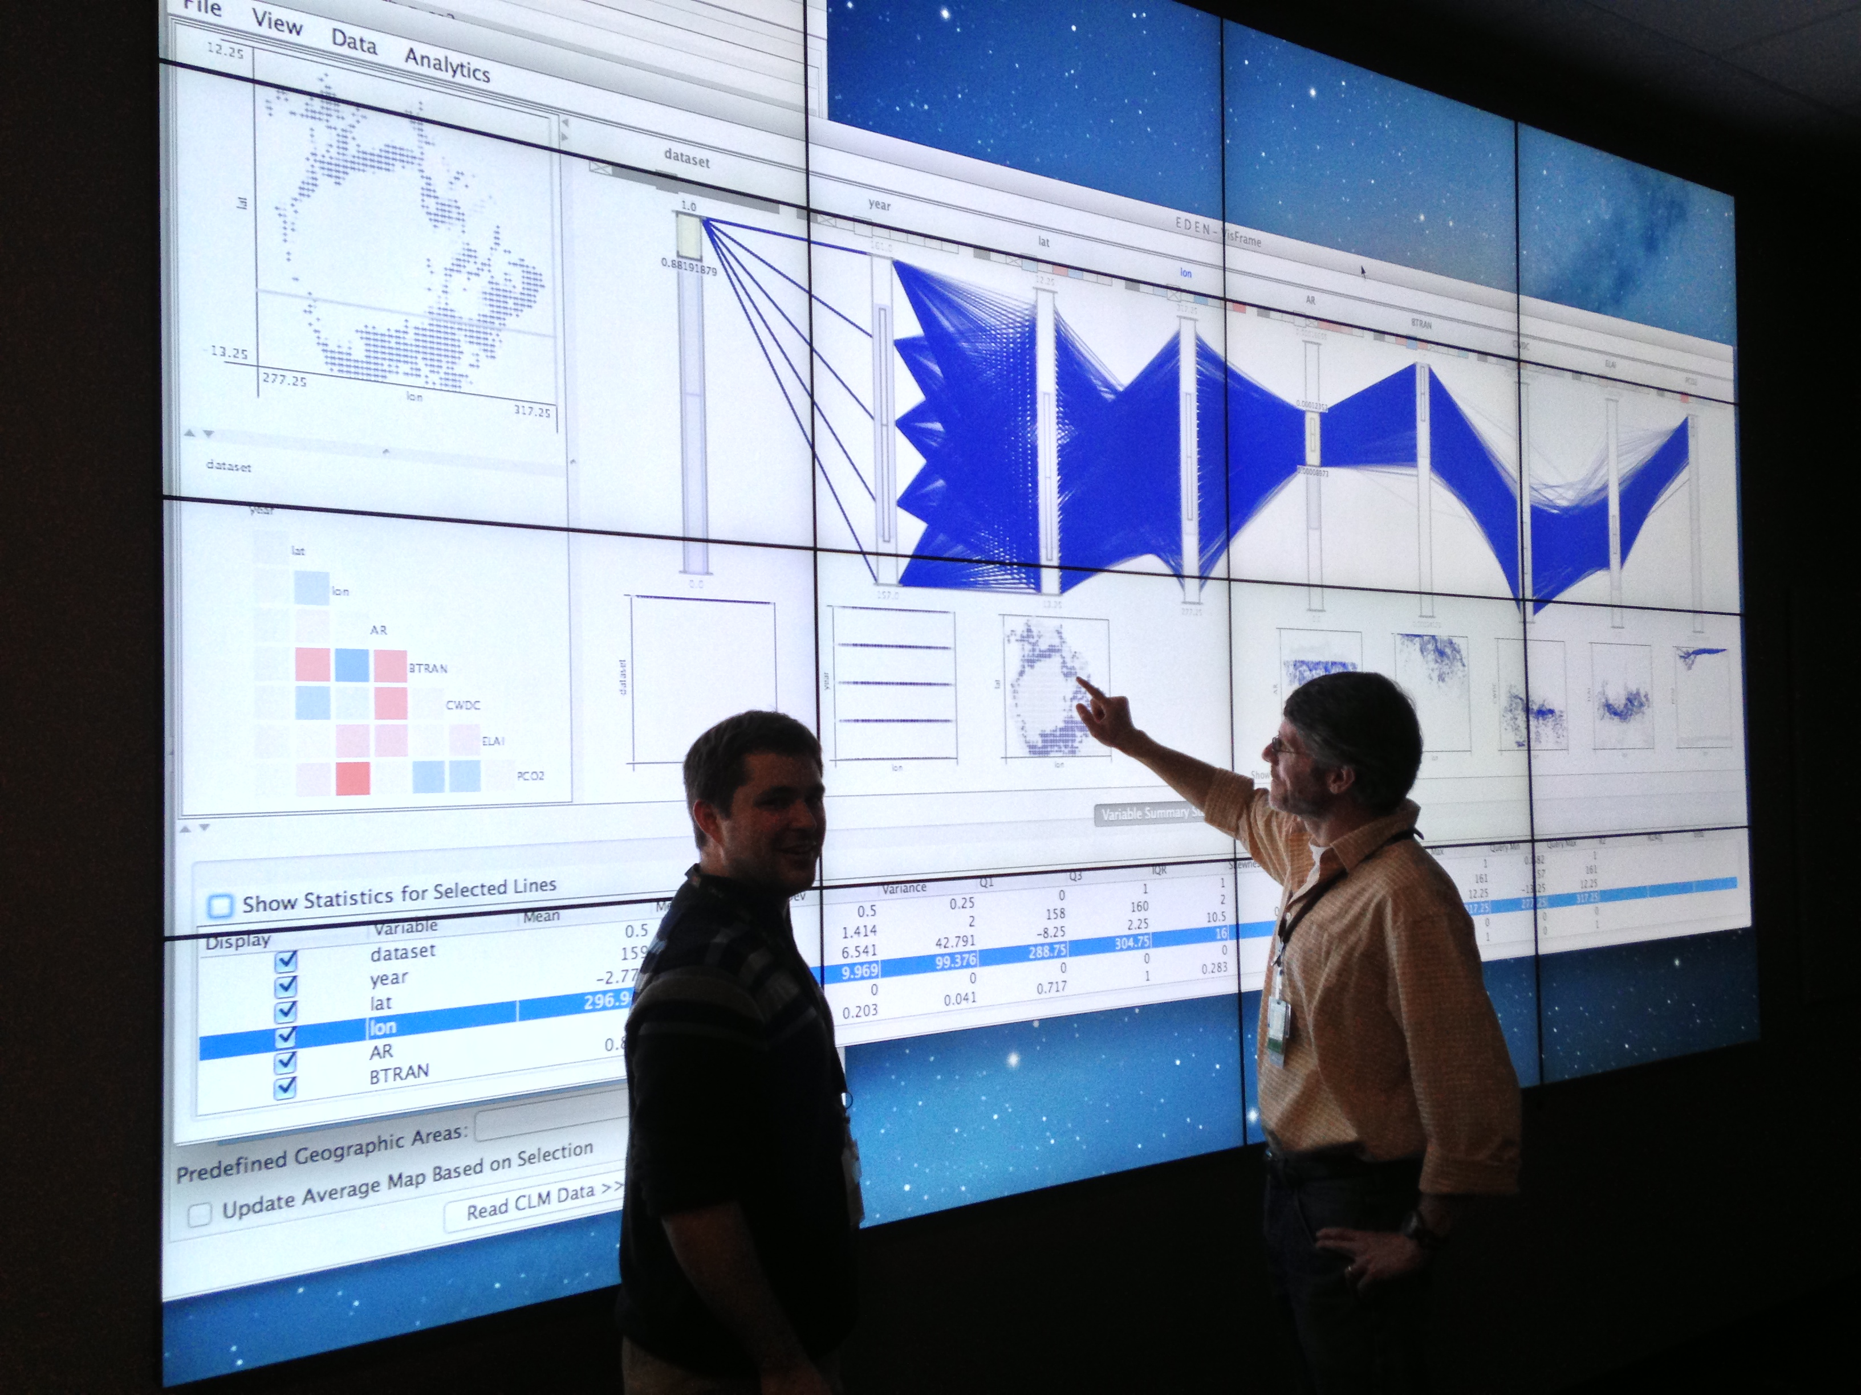
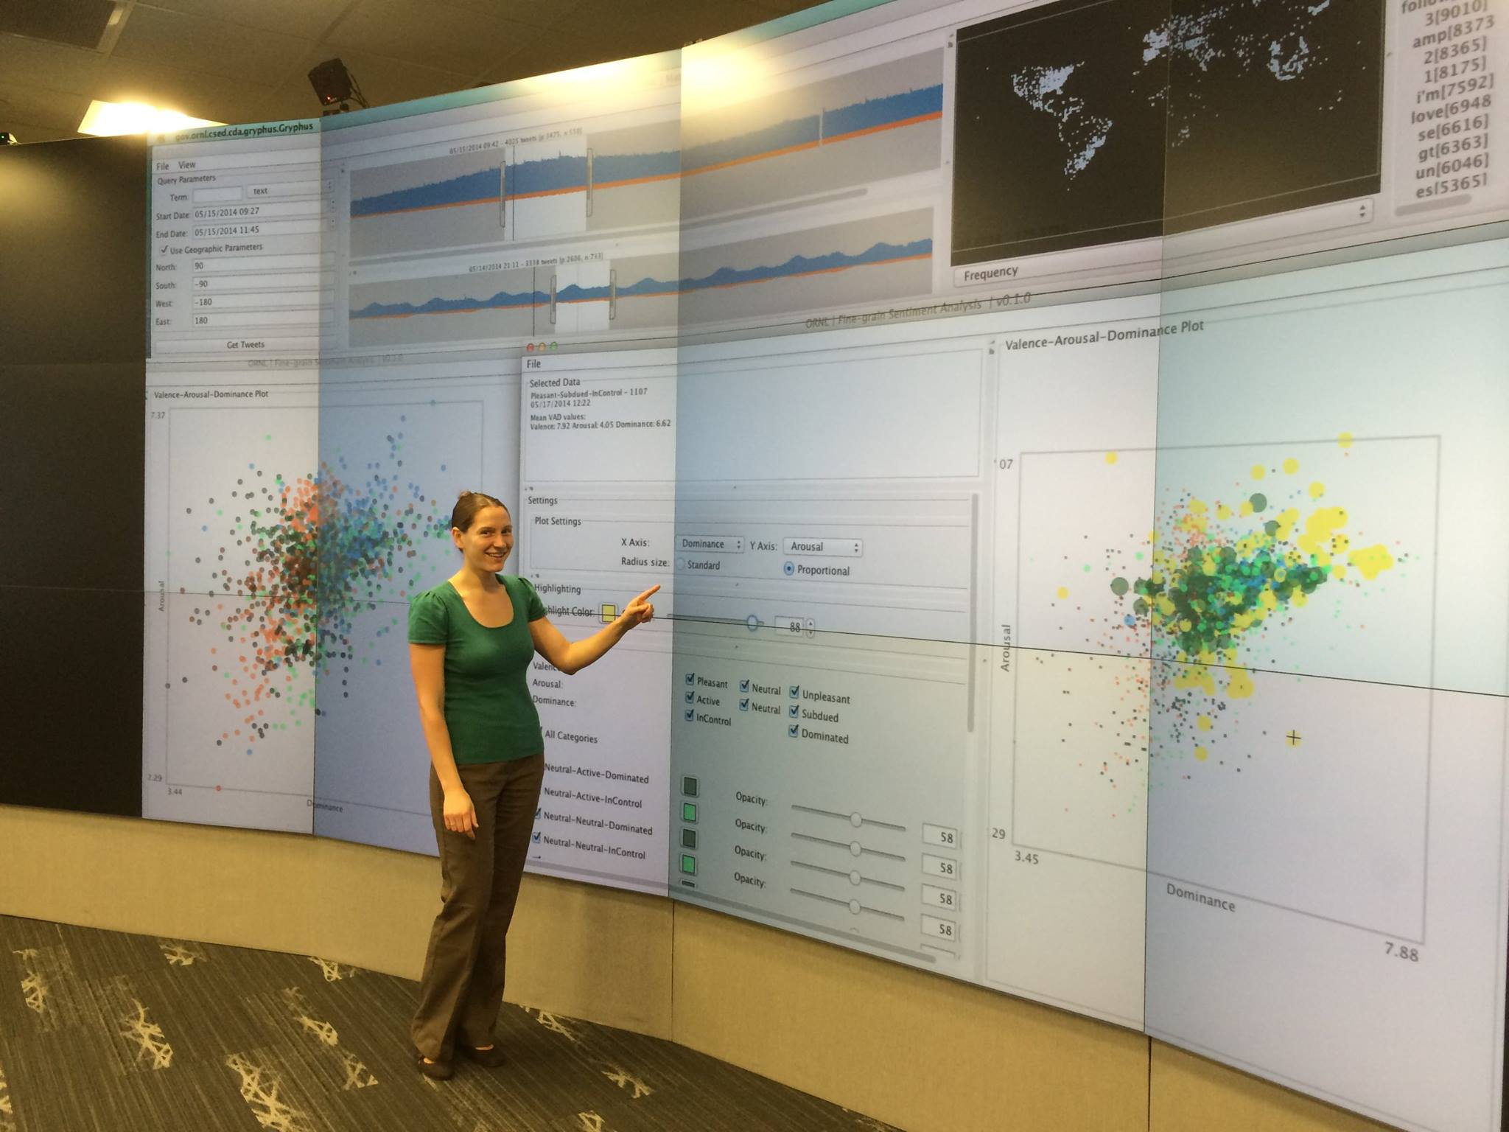
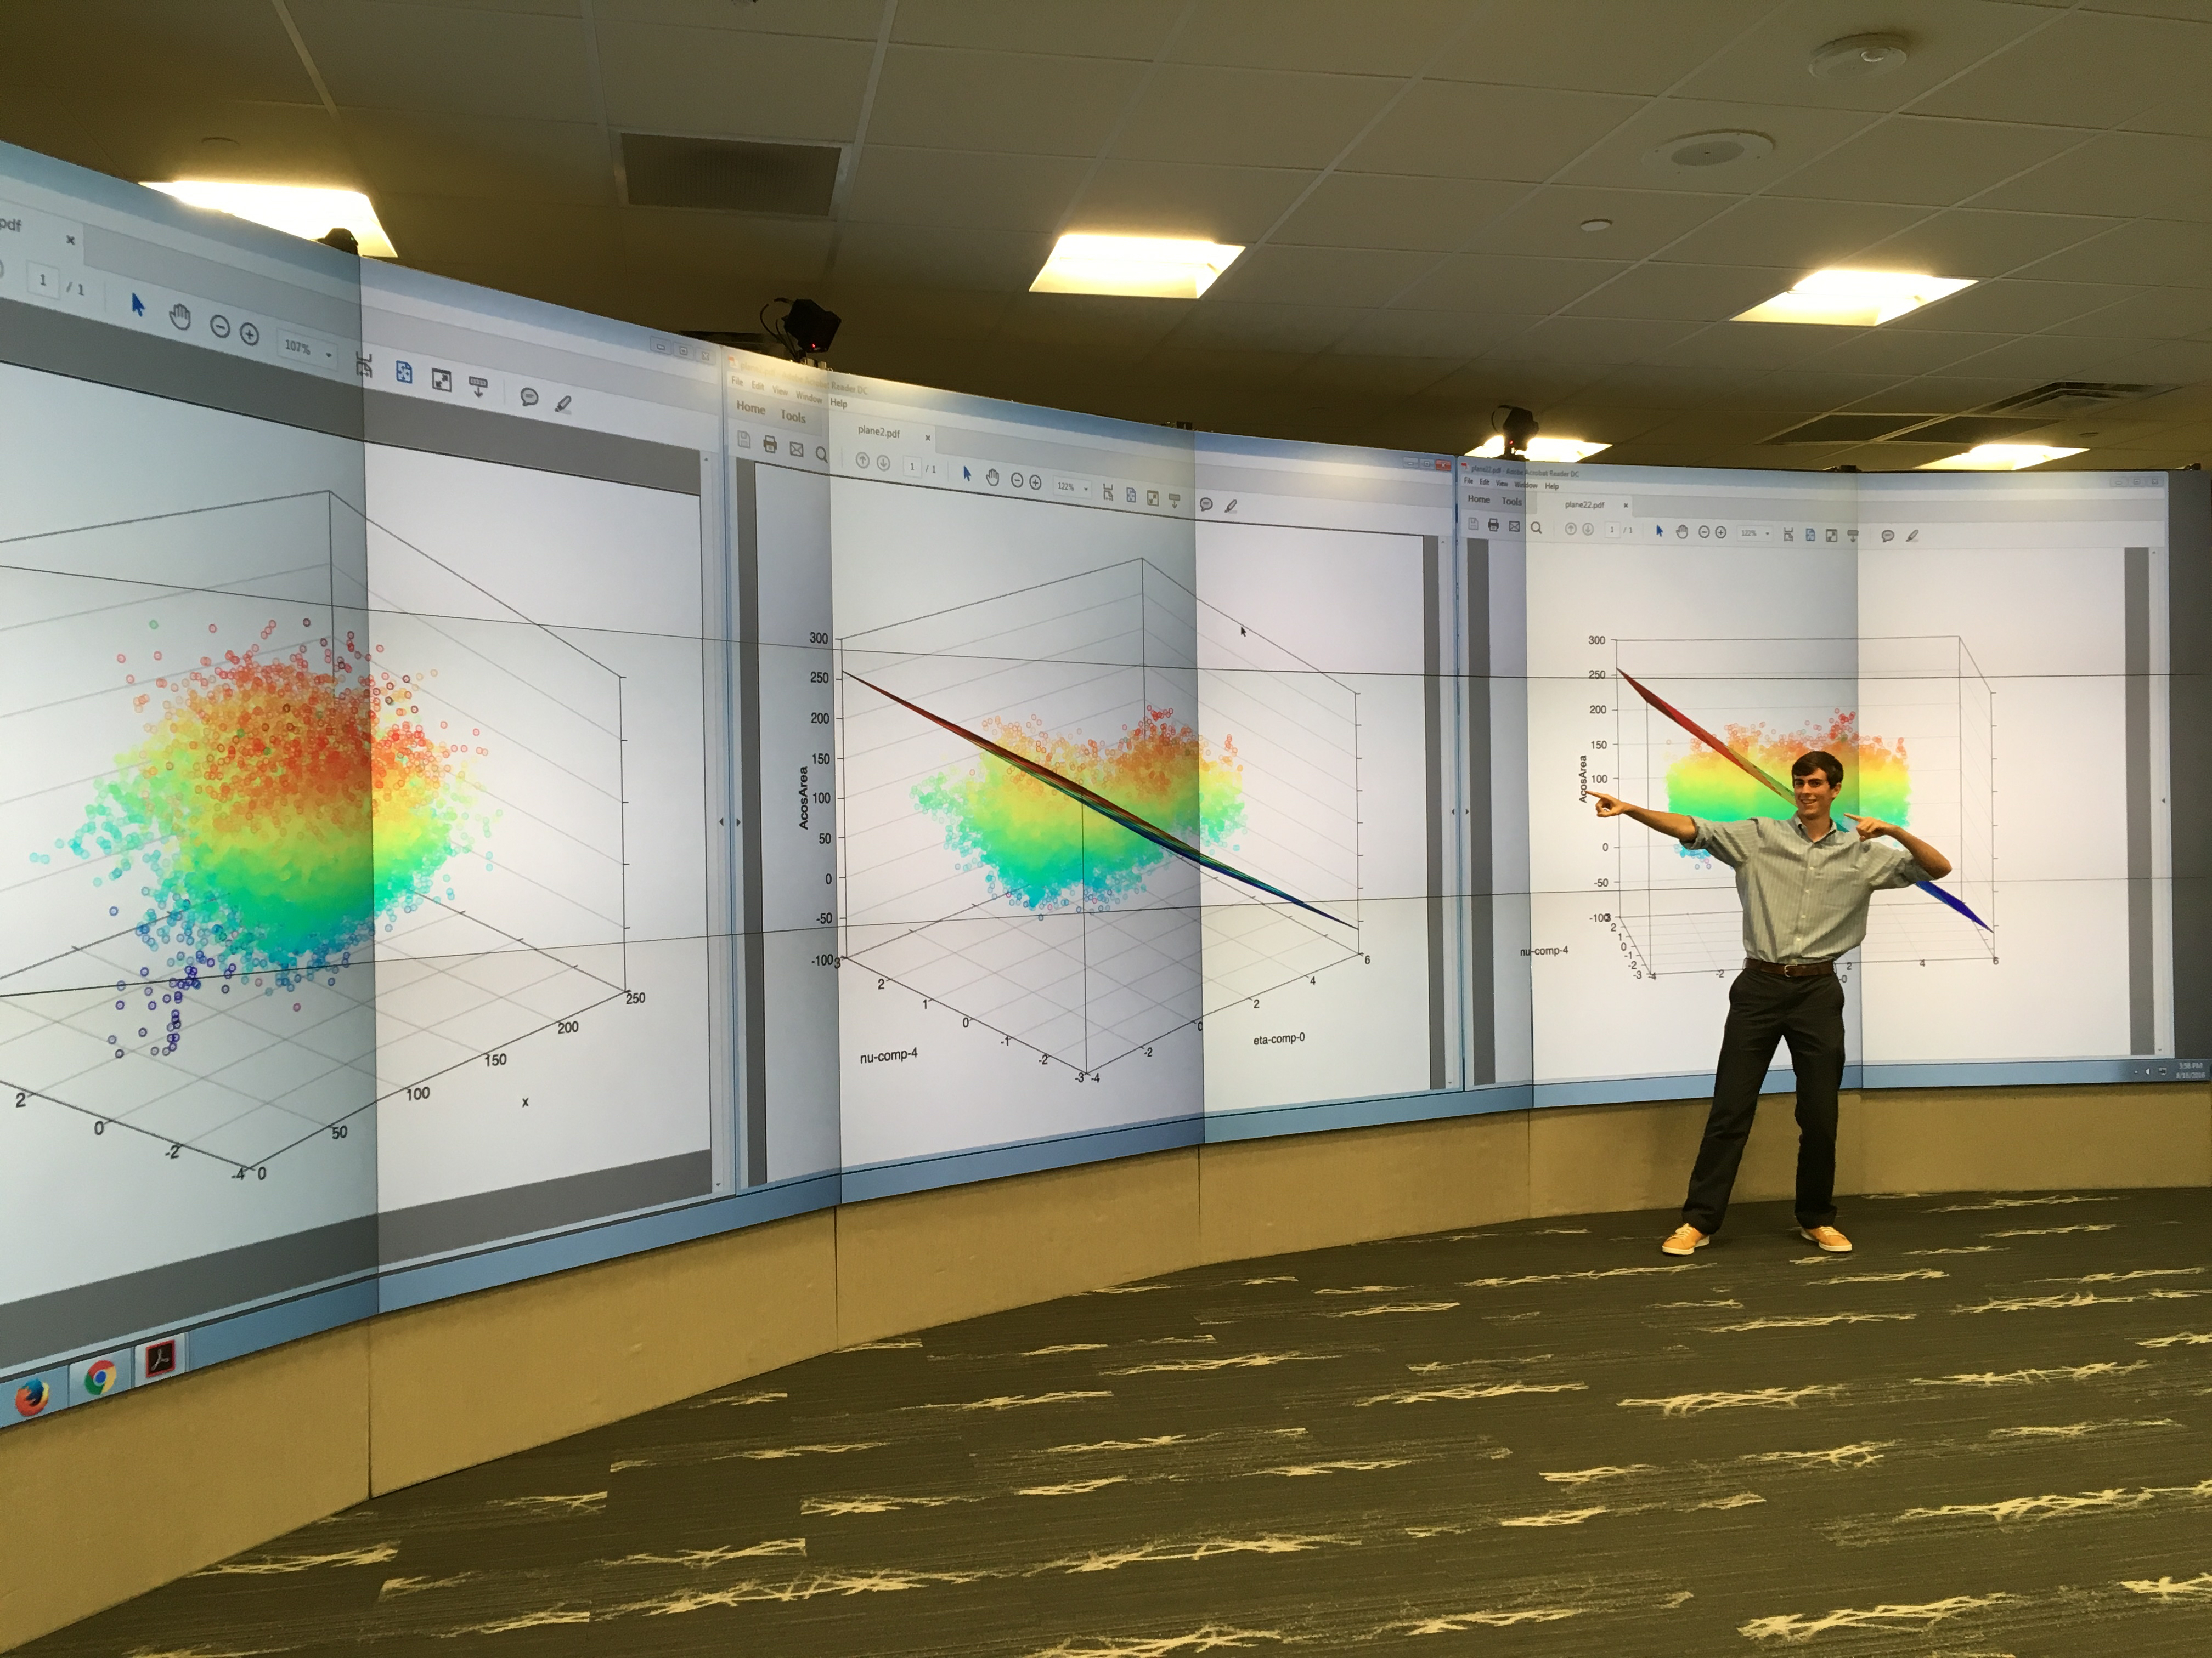
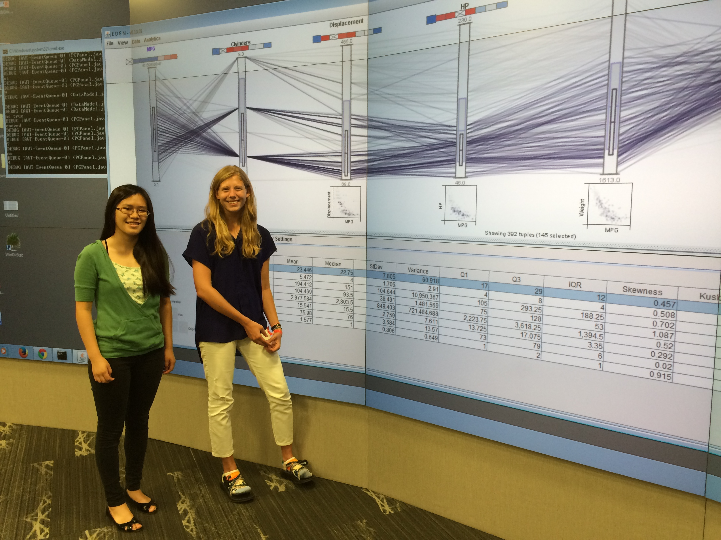
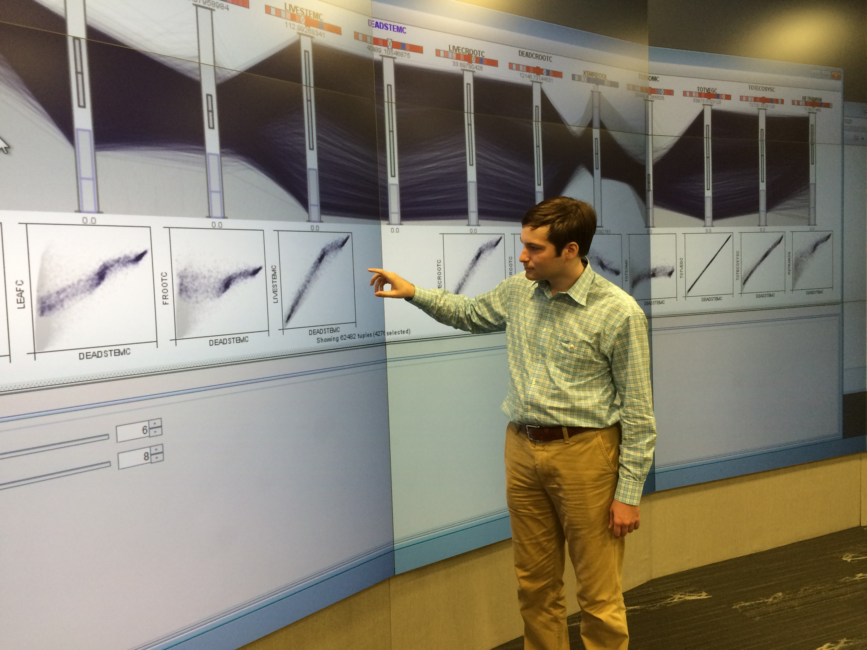
Questions?

